Slide 1
Evaluating Classifiers

Slide 2
What We’ll Cover
Making predictions
Accuracy
Precision, Recall, F1 Score
PR Curve
ROC Curve
Confusion Matrix
Support

Slide 3




Voting
Multiple classifiers to make predictions
Hard softing
Counting total number of yes/nos
Soft voting
Adding up probabilities to make decisions
0.49 0.45 0.87
0.2 0.23 0.45
0.53 0.61 0.45
Hard votes:
1 yes 2 no
3 no
2 yes 1 no
Soft votes:
0.60
0.29
0.53
Notes:
Photo: https://www.flickr.com/photos/107442568@N08/12547327134

Slide 4
Accuracy
Proportion of correct classifications
Good for overview
Not the most useful, doesn’t contain a lot of information
Can be misleading
Notes:
Photo: https://www.flickr.com/photos/107442568@N08/12547327134

Slide 5

Accuracy
Proportion of correct classifications
Good for overview
Not the most useful, doesn’t contain a lot of information
Can be misleading
Notes:
Photo: https://www.flickr.com/photos/107442568@N08/12547327134

Slide 6
Precision
Actual
Proportion of positive classifications that are correct
Precision = TP/(TP+FP)
TP = True positives
FP = False positives
High precision low false positive rate.
Want when FP are very bad
Sales lead identification
Is 1
Is not 1
Is 1
True positive
False positive
Prediction
Is not 1
False negative
True negative

Slide 7
Precision
Is not 1
Is 1
True Positives = 2
False Positives = 1
Precision = 2/(2+1) = 0.66...

Slide 8
Precision
Is not 1
Is 1
True Positives = 3
False Positives = 1
Precision = 3/(3+1) = 0.75

Slide 9
Precision
Is not 1
Is 1
True Positives = 3
False Positives = 2
Precision = 3/(3+2) = 0.6

Slide 10
Precision
Is not 1
Is 1
True Positives = 3
False Positives = 3
Precision = 3/(3+3) = 0.5

Slide 11
Recall
Actual
Proportion of actual positive that are identified
Recall = TP/(TP+FN)
TP = True positives
FN = False negatives
High recall , low number of actual positives that were missed
Want when FN are very bad
Disease or fraud detection
Is 1
Is not 1
Is 1
True positive
False positive
Prediction
Is not 1
False negative
True negative

Slide 12
Recall
Is not 1
Is 1
True Positives = 2
False Negatives = 2
Recall = 2/(2+2) = 0.5

Slide 13
Recall
Is not 1
Is 1
True Positives = 3
False Negatives = 1
Recall = 3/(3+1) = 0.75

Slide 14
Recall
Is not 1
Is 1
True Positives = 3
False Negatives = 1
Recall = 3/(3+1) = 0.75

Slide 15
Recall
Is not 1
Is 1
True Positives = 3
False Negatives = 1
Recall = 3/(3+1) = 0.75

Slide 16
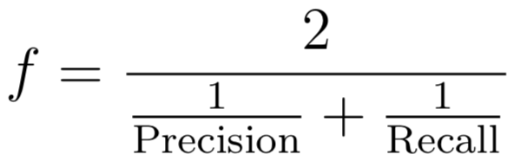
F1 Score
When precision goes up, recall goes down, and vice versa
If your problem not specific to demanding recall/precision
Harmonic mean of the two
1 is best, 0 is worst

Slide 17
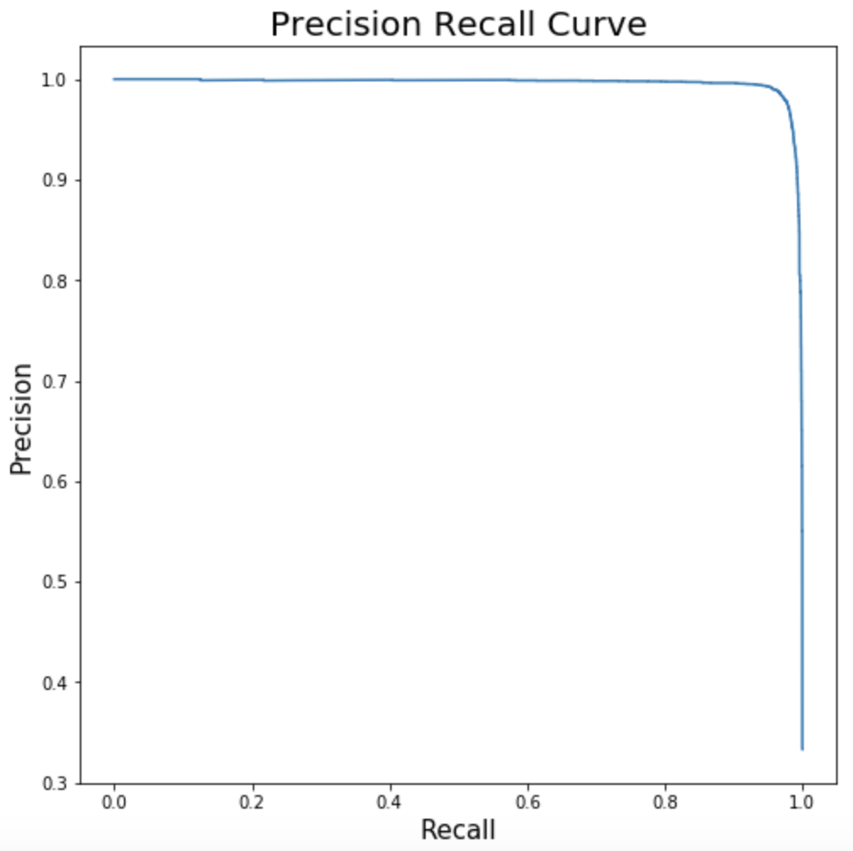
PR Curve
Plot precision versus recall for various thresholds
Depending on your need, choose best region
Want curve to go towards top right

Slide 18
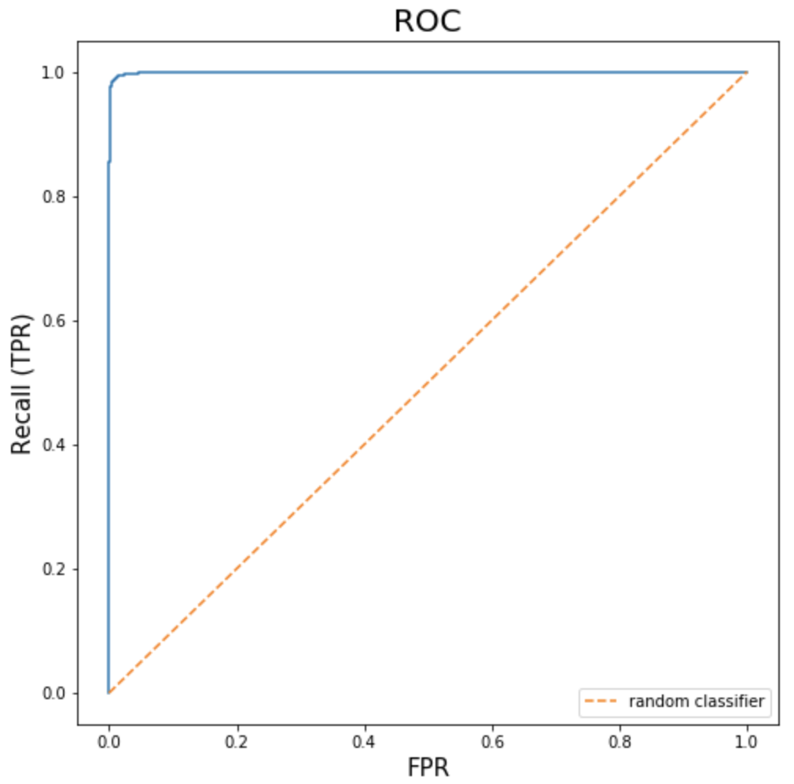
ROC
Receiver operating characteristic
Recall (true positive rate) vs false positive rate
Want curve to go to top left
AUC
Area under curve
AUC Score of 1 is best, 0.5 is random
Good general metric to compare classifiers

Slide 19
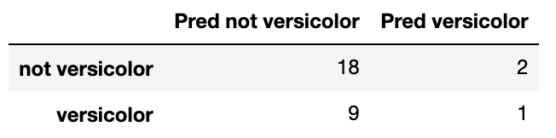
Confusion Matrix
Table breakdown of errors
Diagonal shows correct classifications
Reading the matrix
Rows indicate true values
Columns show predicted values
Conventions vary though
Documentation on sklearn is current wrong with description

Slide 20
Support
Number of occurrences of each class in the true targets
True targets
Occurrences
1 2 3 4 5 6

